Slide 1
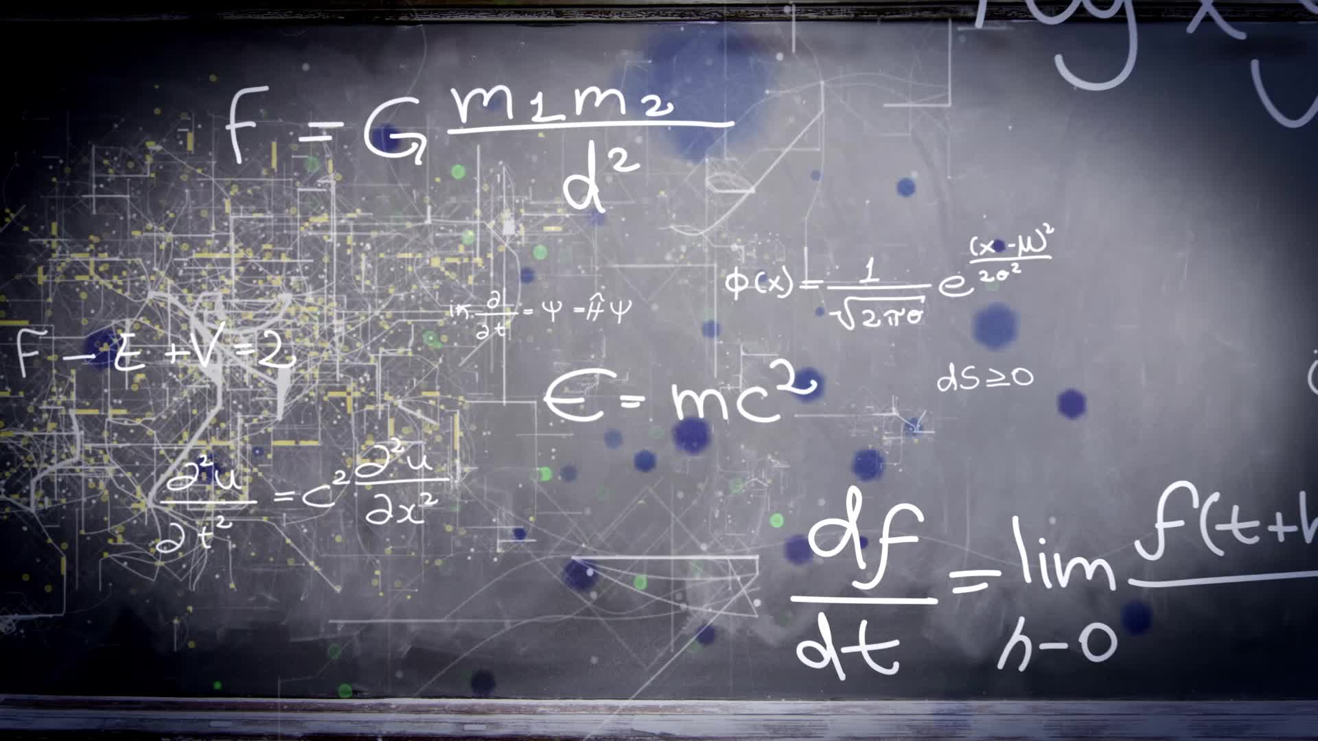

The Einstein-Rosen-Podolsky Hypothesis and its Experimental Falsification
Nathan Bárbola Marucci

Slide 2

Sumário
Introduction
  Determinism x Causality
  Viewpoint
    Realist
    Orthodox
    Agnostic
Historical context
EPR Paradox
  Quantum entanglement
  Spin correlation
Bell’s inequality
Aspect’s Experiment
Conclusion

Slide 3
Introdução

Slide 4


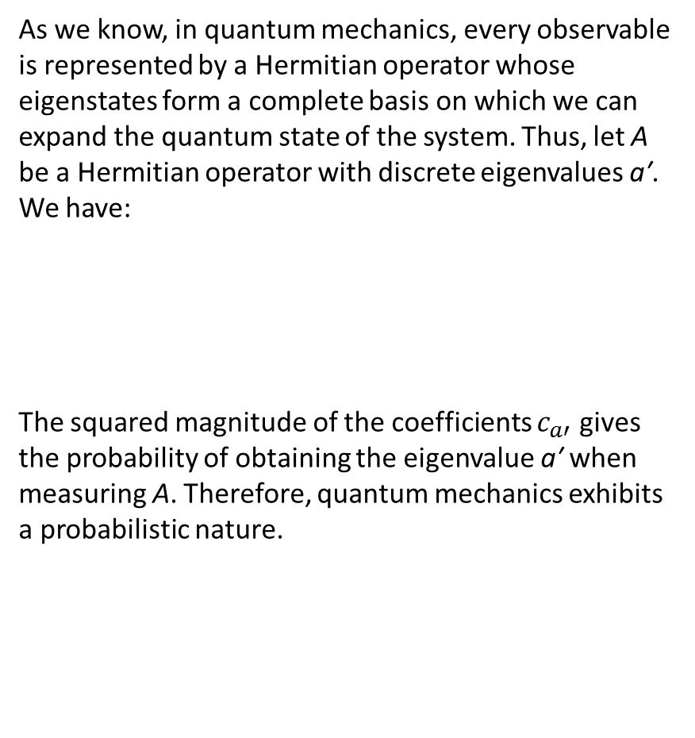
Determinism X Causality
As we know, in quantum mechanics, every observable is represented by a Hermitian operator whose eigenstates form a complete basis on which we can expand the quantum state of the system. Thus, let A be a Hermitian operator with discrete eigenvalues a′. We have:
The squared magnitude of the coefficients $c_{a′}$ gives the probability of obtaining the eigenvalue a′ when measuring A. Therefore, quantum mechanics exhibits a probabilistic nature.
On the other hand, once we know the initial quantum state of the system, we can determine how it evolves over time through the Schrödinger equation:
Hence, in terms of the system’s evolution, quantum mechanics is deterministic.

Slide 5
Viewpoint
Orthodox
Agnostic
Realist

Slide 6
Realist
The act of measuring disturbs the system – Uncertainty Principle
There are Hidden Variables
Quantum mechanics was not wrong, but incomplete
The Nature should not be probabilistic, but rather entirely deterministic

Slide 7
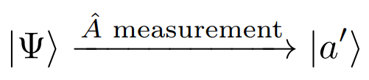
Orthodox
There aren’t Hidden Variables
Nature is intrinsically probabilistic
Quantum mechanics is complete
The collapse of the wave function

Slide 8
Agnostic
Discussions about the nature of Quantum Mechanics are purely philosophical.
Quantum theory agreed with experimental observations

Slide 9
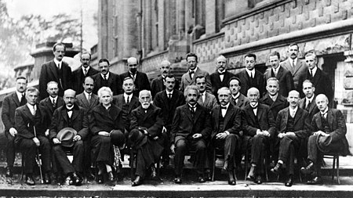
Historical Context

Slide 10
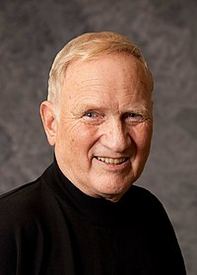

Historical Context
1935
EPR Paper (Gedankenexperiment)
1964
Bell’s Theorem
1980-1982
Aspect’s experiments
1951
Bohm's variant
1969
Clauser, Horne, Shimony and Holt extended Bell’s theorem to include actual systems
John Clauser
Alain Aspect

Slide 11
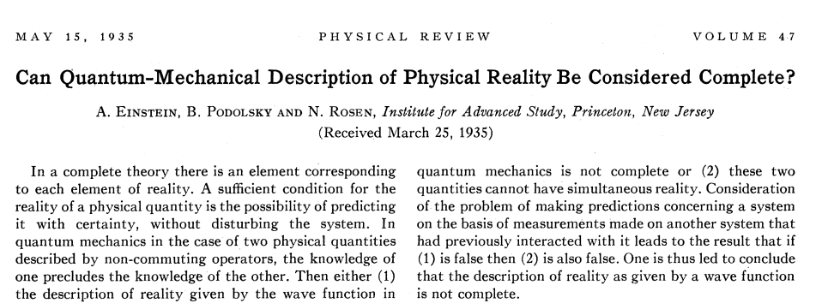
EPR Paradox

Slide 12
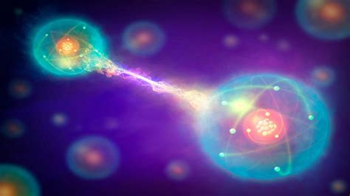

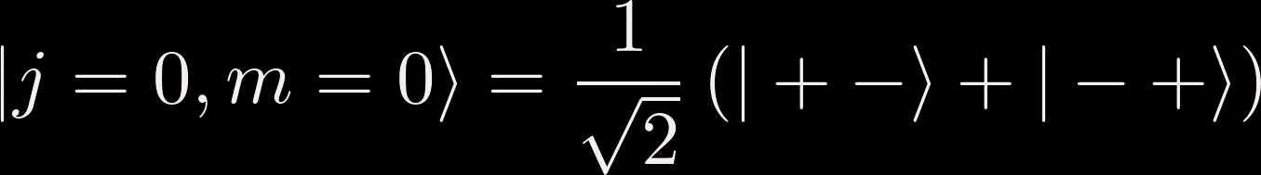
Quantum entanglement
Consider the decay of a neutral pion in the initial singlet state into an electron and a positron
Thus, the system will be given by:

Slide 13
Spin Correlation
Due to the uncertainty principle, we cannot know more than one component of spin precisely
We can measure any spin component of electron we want by simply rotating the experimental setup.
How does positron know which spin component of electron is being measured, if they are separated by a large distance and there is no interaction between them or between positron and the experimental setup?
Locality

Slide 14
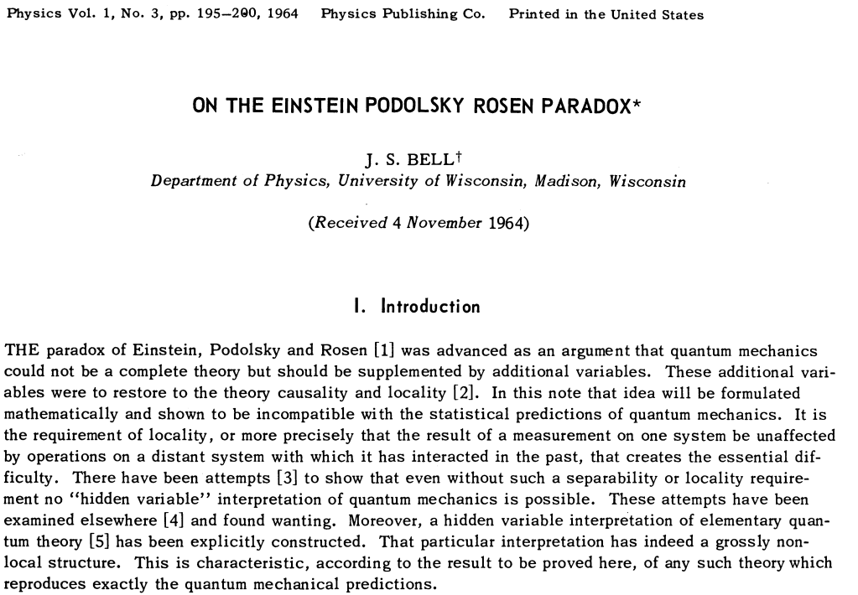
Bell’s Inequality

Slide 15
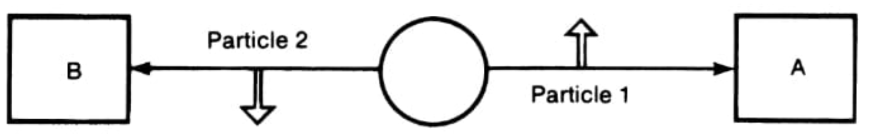


Bell’s Inequality
Bell proposed calculate the average value of the spin product for a set of detector orientation
Let this average be denoted by P(a,b).
For arbitrary orientations, quantum mechanics predicts:
However, Bell discovered that this is incompatible with any theory of hidden variables!
A’s result | B’s result | Product
+ | + | +
+ | - | -
- | + | -
- | - | +

Slide 16

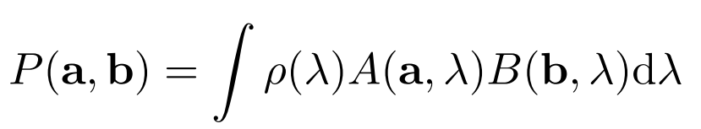
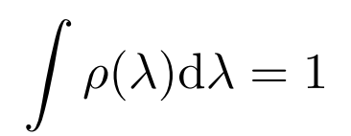
Bell’s Inequality
Suppose that the "complete" state of the system is characterized by the hidden variable λ.
There must exist a function A(a, λ) that gives the electron’s measurement result, and another function B(b, λ) for the positron’s measurement result.
Obviously, the average of the product of the measurements will be
where ρ(λ) is a probability density for the hidden variable. And, like any probability density, it must be non-negative and satisfy the normalization condition

Slide 17
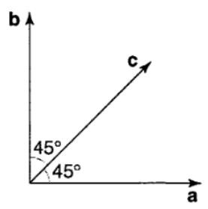

Bell’s Inequality
So, Bell arrived at the following inequality that must be obeyed by any theory of hidden variables
It is easy to see that the prediction of quantum mechanics is incompatible with Bell’s inequality.
This violates Bell’s inequality, demonstrating the non-locality of quantum mechanics.

Slide 18
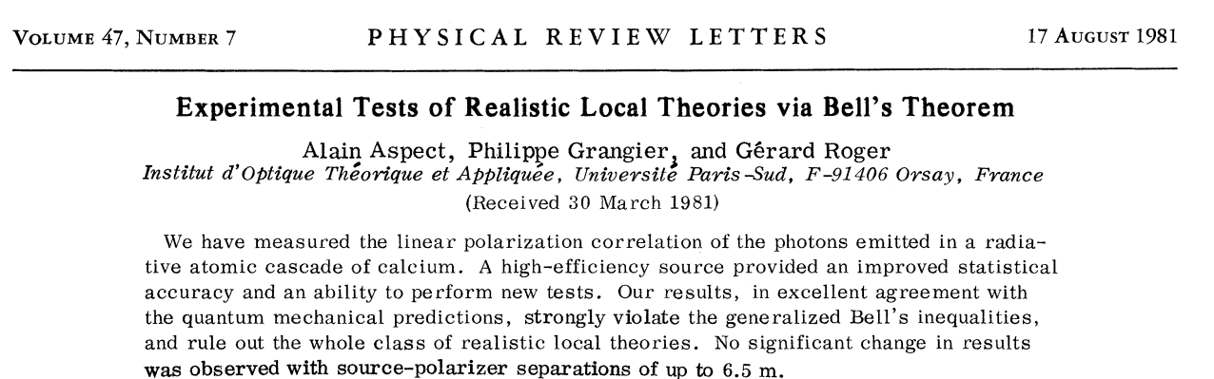
Aspect’s Experiment

Slide 19
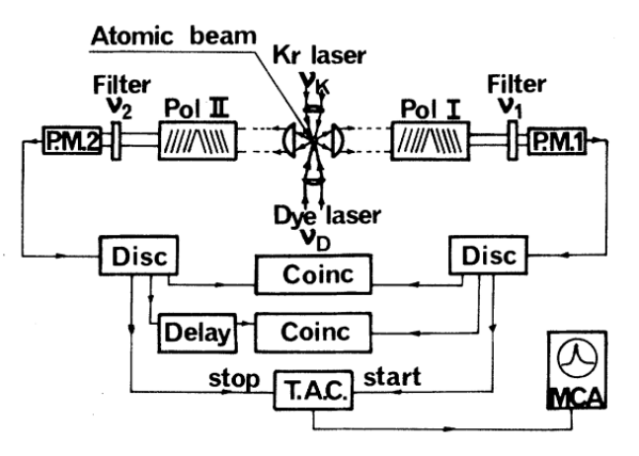
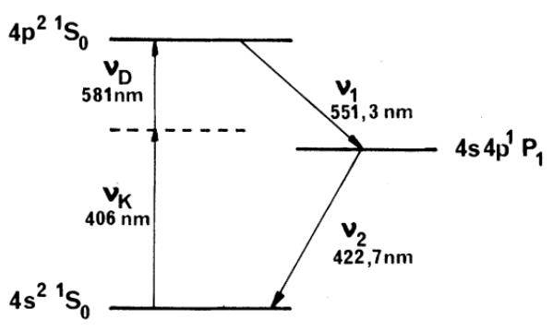
Aspect’s Experiment
Aspect’s experiment will use the following transitions:
Schematic diagram of the apparatus and electronics
Relevant levels in Calcium

Slide 20
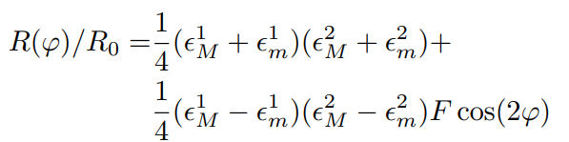
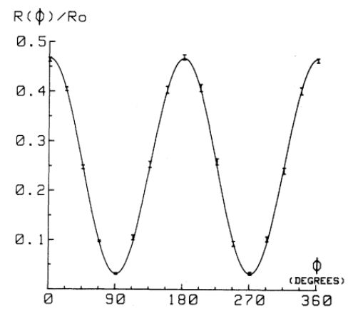


Aspect’s Experiment
The transmittance ${\text{ϵ}}_{M}^{i}$and ${\text{ϵ}}_{m}^{i}$of the polarizers (i = 1 or 2) for parallel or perpendicular polarized light were then measured: ${\text{ϵ}}_{M}^{1}$ = 0.971 ± 0.005, ${\text{ϵ}}_{m}^{1}$= 0.029 ± 0.005, ${\text{ϵ}}_{M}^{2}$ = 0.968 ± 0.005, and ${\text{ϵ}}_{\text{m}}^{\text{2}}$ = 0.028 ± 0.005.
The coincidence rate R(φ), $R_{i}$ e $R_{0}$ were measured and quantum mechanics predicts that:
Where F = 0.984 is an equipment adjustment parameter.

Slide 21

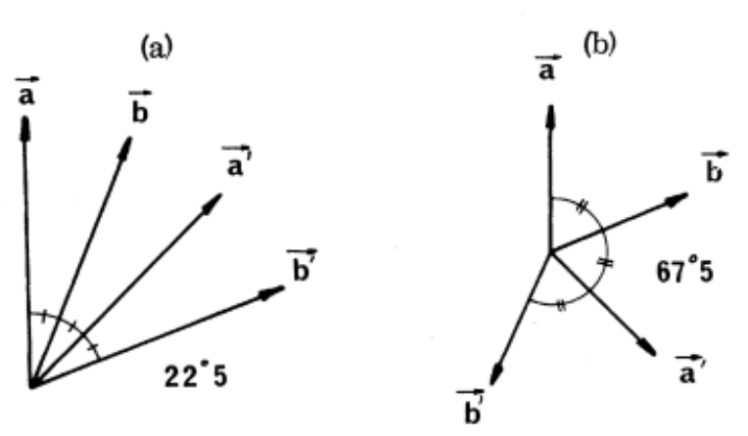

Aspect’s Experiment
The generalized Bell theorem yields the following inequality:
where S = [R(a,b)−R(a,b′)+R(a′,b)+R(a′,b′)− $R_{1}$(a′) − $R_{2}$(b′)]/ $R_{0}$.
We can see that the maximum violation of the inequality is predicted by Quantum Mechanics (QM) for the set of orientation:
Thus, the experimental value obtained for S in this configuration was Sexp = (0.126 ± 0.014). This value violates Bell inequality and is consistent with the result predicted by quantum mechanics SQM = 0.118 ± 0.005.

Slide 22
Conclusion
The quantum theory is one of the most successful theories
Through works using entangled photons, their completeness and non-locality have been demonstrated
Alain Aspect, John Clauser, and Anton Zeilinger received the Nobel Prize in Physics for their work with entangled photons, establishing the violation of Bell's inequality and paving the way for the development of quantum information

